Slide 1
Introduction to Django #3
`09 Summer SPARCS Seminar
SPARCS `08
서우석(pipoket)

Slide 2
You know Database
Table
Row Record
Column Attribute
DB
(Relational DBMS)

Slide 3
Relational DB Format
Table
Column
STUDENT
ID | Name | Age
20080001 | Jake | 20
20080002 | Mike | 19
20080003 | Jane | 19
20080004 | Anna | 20
Row

Slide 4
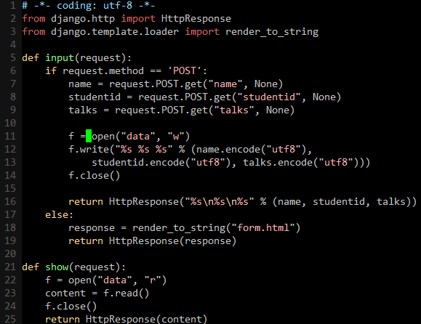
You already have it!
Your own “Database”!
Your own “Format”

Slide 5

What if?
data
(file)
Collision

Slide 6
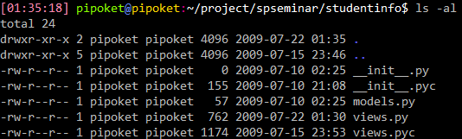
So we use…
models.py

Slide 7
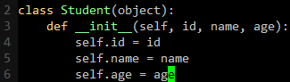
Django = OODB
STUDENT
ID | Name | Age
20080001 | Jake | 20
20080002 | Mike | 19
20080003 | Jane | 19
20080004 | Anna | 20
Student.id
Student

Slide 8
What`s the difference?
Originally…
STUDENT
ID | Name | Age
20080001 | Jake | 20
20080002 | Mike | 19
20080003 | Jane | 19
20080004 | Anna | 20
SELECT id, name, age
FROM student
WHERE id=20080003

Slide 9
What`s the difference?
In Django…
STUDENT
ID | Name | Age
20080001 | Jake | 20
20080002 | Mike | 19
20080003 | Jane | 19
20080004 | Anna | 20
from model import student
res = student.get(id=“20080003”)
print res.name

Slide 10
Difference!
You don`t know SQL
You don`t know DBMS
You only know Python
You know python! OK!

Slide 11
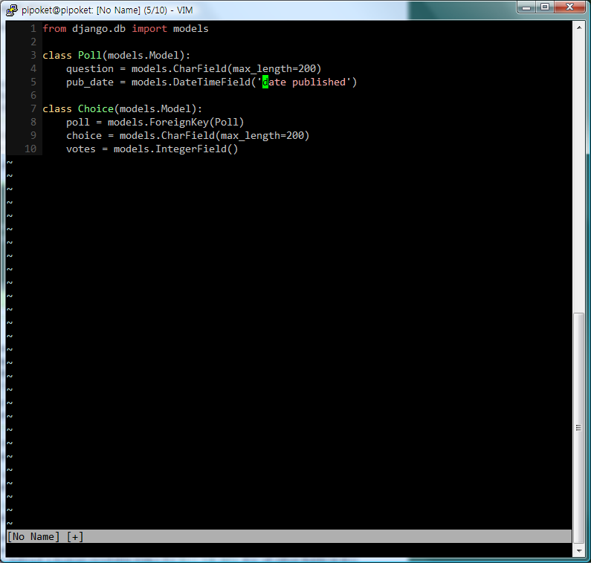
Creating Table
models.py
Table is also Object!
Making Class == Making Table

Slide 12
Creating Table – Field Types
Data Type | Field Name
integer | IntegerField()
string (length fixed) | CharField(max_length=100)
string (long length) | TextField()
datetime | DateTimeField()
boolean | BooleanField()

Slide 13
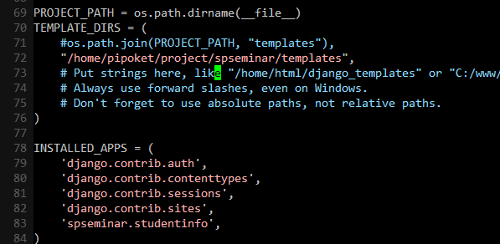
Notify Django about Table
settings.py
Add your application with models.py

Slide 14
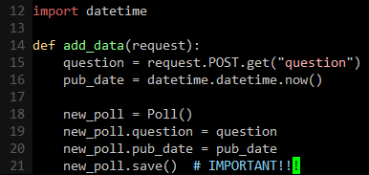
Adding Data
Row is also Object!
YOU NEED THIS TO SAVE

Slide 15
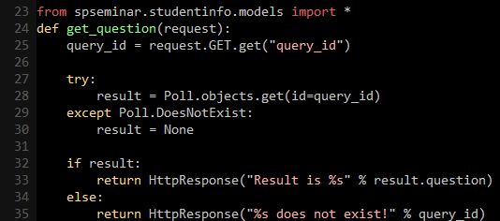
Retrieving data
When not found
Getting row object
Row == Object !!

Slide 16
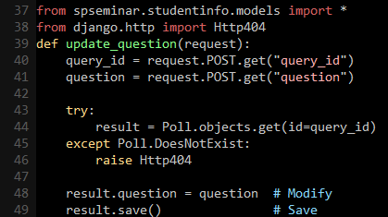
Modifying data
Get object to modify
Modify and Save!

Slide 17

Deleting data
Get object to delete
Delete!

Slide 18
Summary
Table Define class in models
Column Define Fields in class of models
Row
Create Object with class in models
Get Function in class of models
Modify Get object, Modify and Save
Delete Get object, Call delete function

Slide 19
Practice
Change homework of 2 weeks ago.
Make it work with database.
…..
Okay, Let`s do it together

